Slide 1
Chapter 6
Defining Behaviors and Detecting Collisions

Slide 2
This Chapter
Start thinking about behavior
Implement autonomous, controlled, gradual turning and target-locked chasing behaviors
Needs for collision detection
Simple: Axis-Aligned BBOX
Collide textured objects accurately
Per-Pixel-accurate collision
Understand algorithm and efficiency
Derive and implement general solution

Slide 3
Review: Where are we?
Chapter 2+3: Hides Drawing
GLSL Shader, SimpleShader, Renderable
Chapter 4: Utility components
Loop, Keyboard input
Scene object: API interface
Resources management, Audio
Chapter 5: Drawing of “objects” as textures and animation
TextutreShader and TextureRenderable
Sprite animation
Font
Need: Abstract behavior wrapping

Slide 4
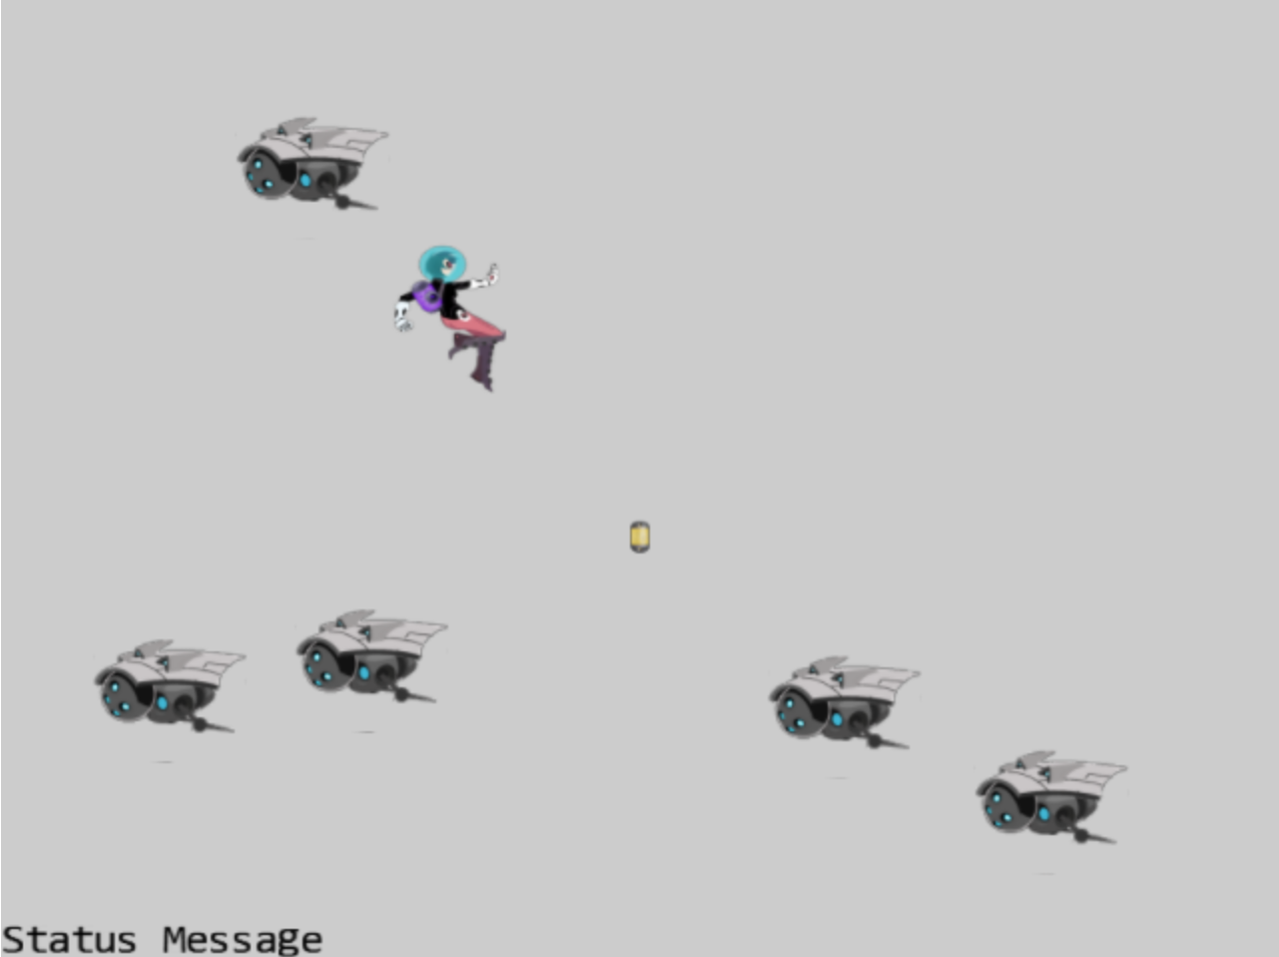
6.1: GameObjects Project

Slide 5
6.1: Goals
Define the GameObject:
To begin abstract/hide behavior implementation
Clean up drawing interface: should pass in Camera

Slide 6
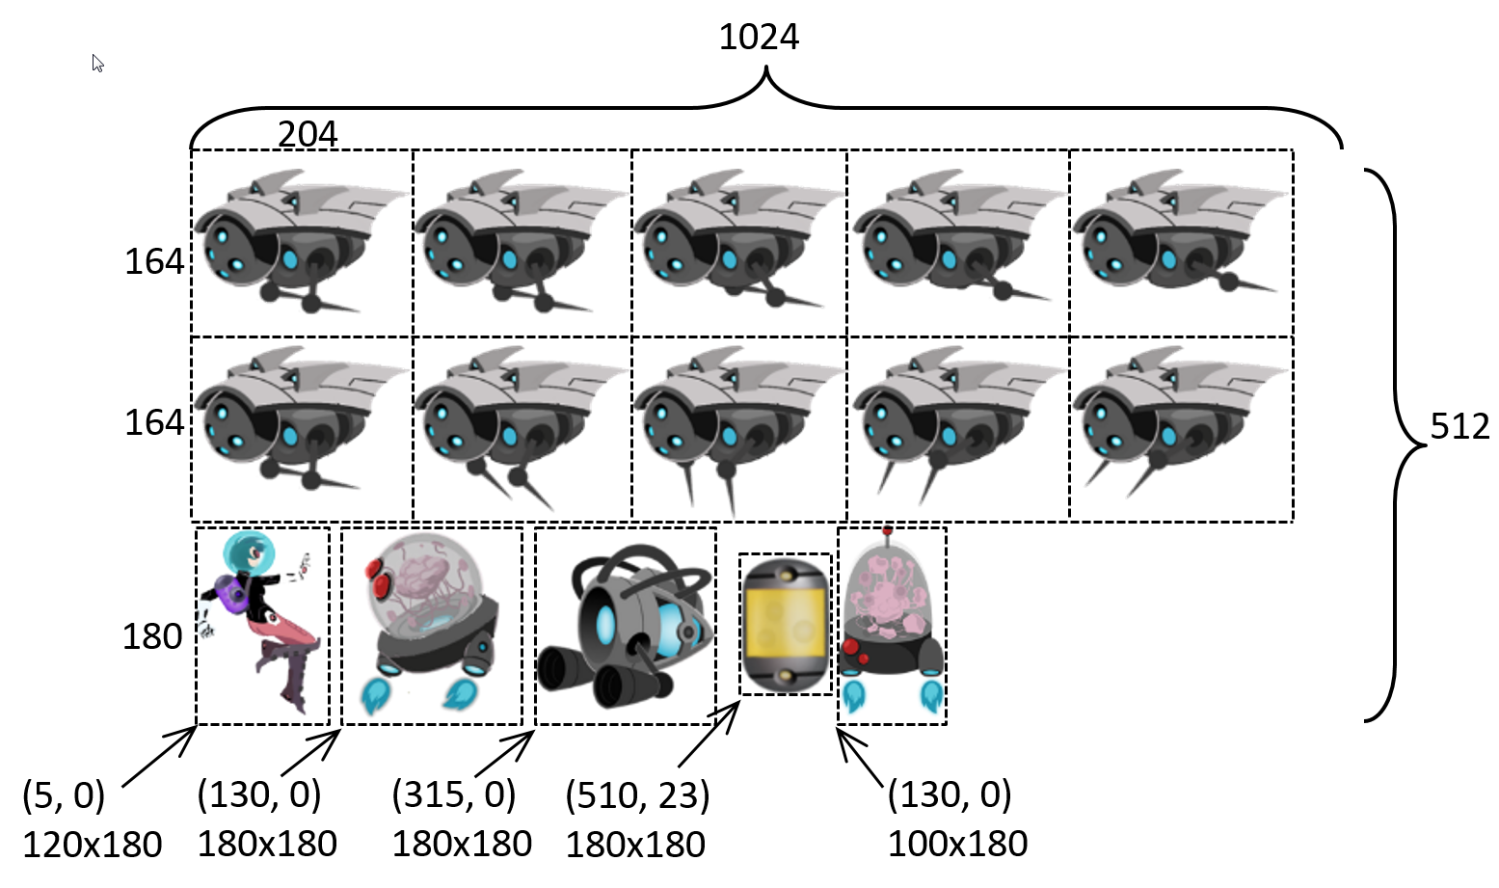
New sprite element

Slide 7
GameObject: capturing behaviors!
update()
Implements object behaviors
Has a renderable
Can be drawn
Has a xform
Can be manipulated
Logical place to define behavior
Renderable: is appearance
GameObject: is behavior

Slide 8
GameObjectSet:
Set of GameObjects
Set maintenance
Add/Size/Access
GameObjects support
update/draw

Slide 9
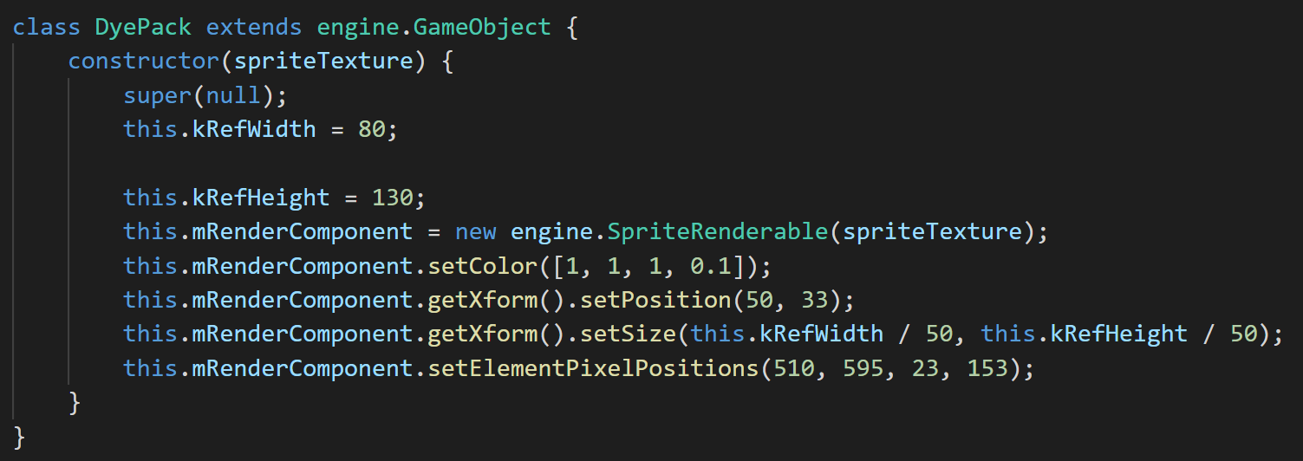
Work with GameObject
Custom object: DyePack

Slide 10
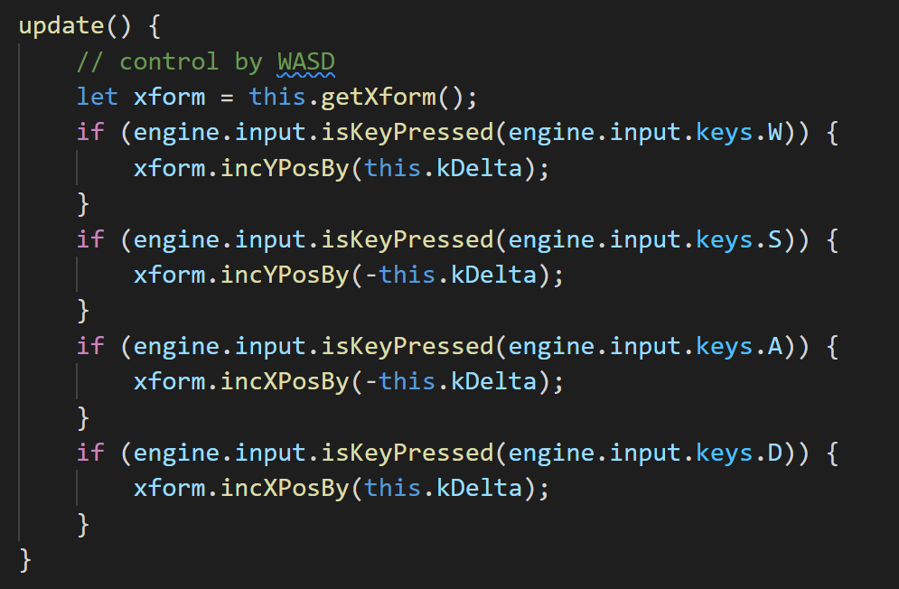
The Hero
Another example of subclass from GameObject
Behavior in Hero::update()
Hidden from MyGame
Avoid code clustering in MyGame

Slide 11
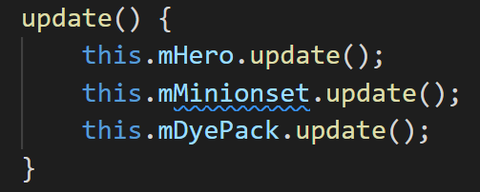
Minion’s interesting behavior
MyGame: no need to have any knowledge of how minion’s behave!
This is MyGame::update()

Slide 12
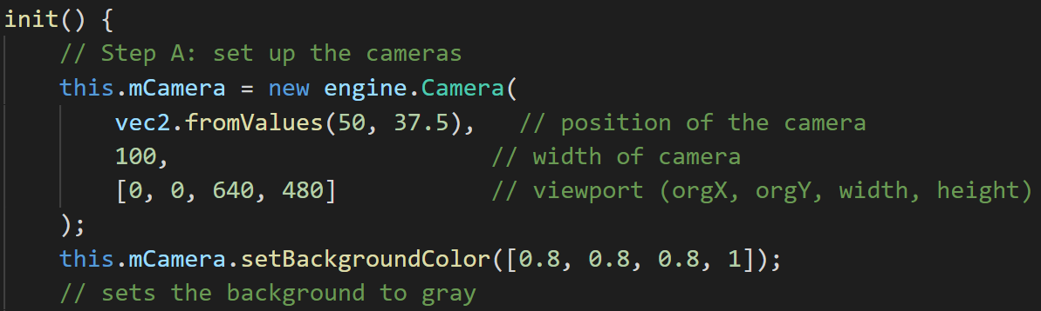
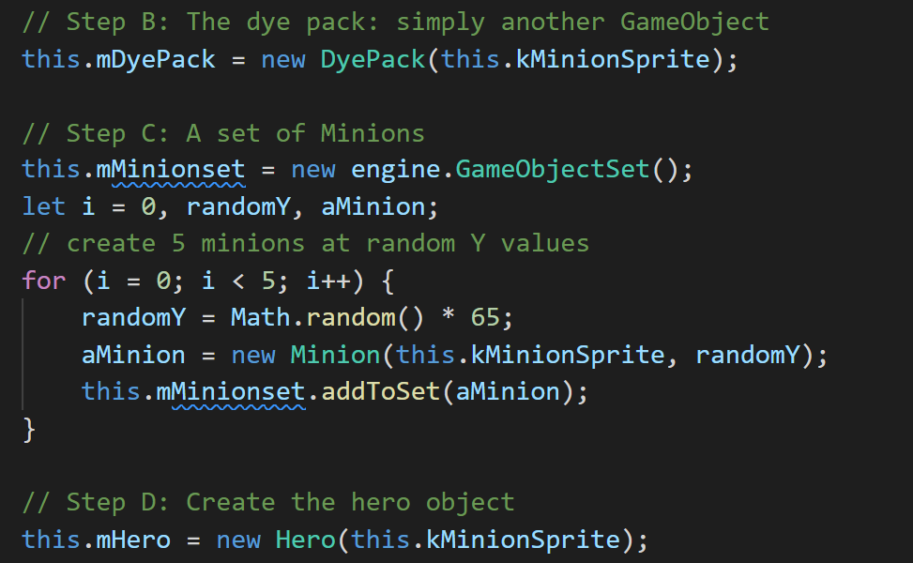
MyGame::init()
Much cleaner object creation!

Slide 13
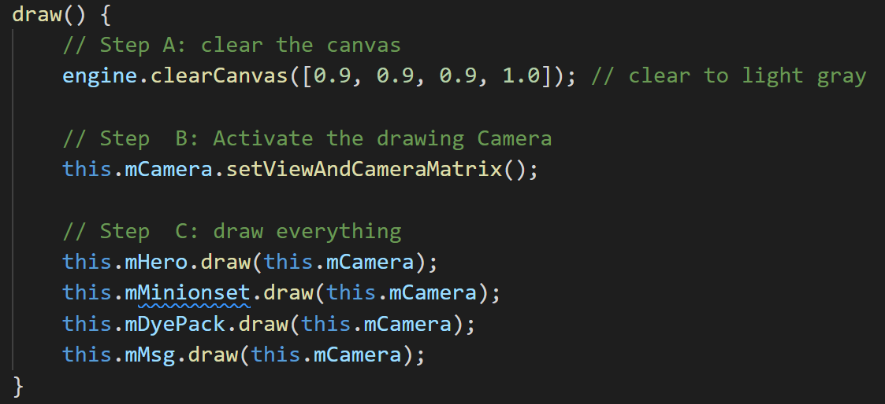
MyGame draw()
draw()
Init camera
Pass camera to GameObjects

Slide 14
MyGame update()
Core of game logic:
Each object updates state
No object interact:
So, that’s that!
Notice:
MyGame does not know anything about each object
Control/Behavior: all hidden inside each object
MyGame: will take care of interaction of objects (to come)!
For objects to interact: need to be aware of other objects!

Slide 15
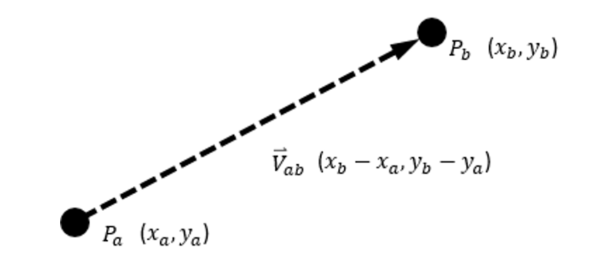
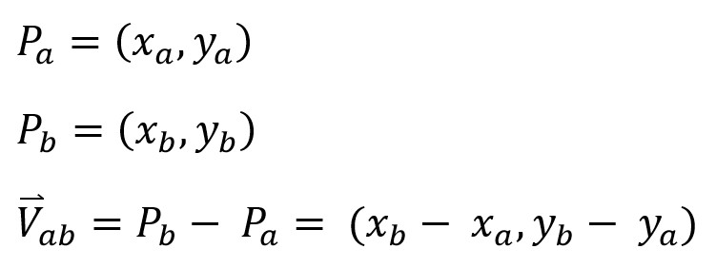
Vectors: Review
From point to point
Has a size
Magnitude, length, distance

Slide 16
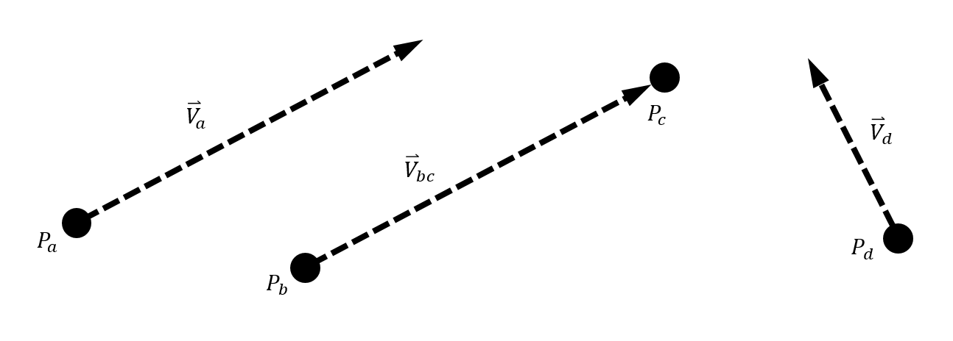
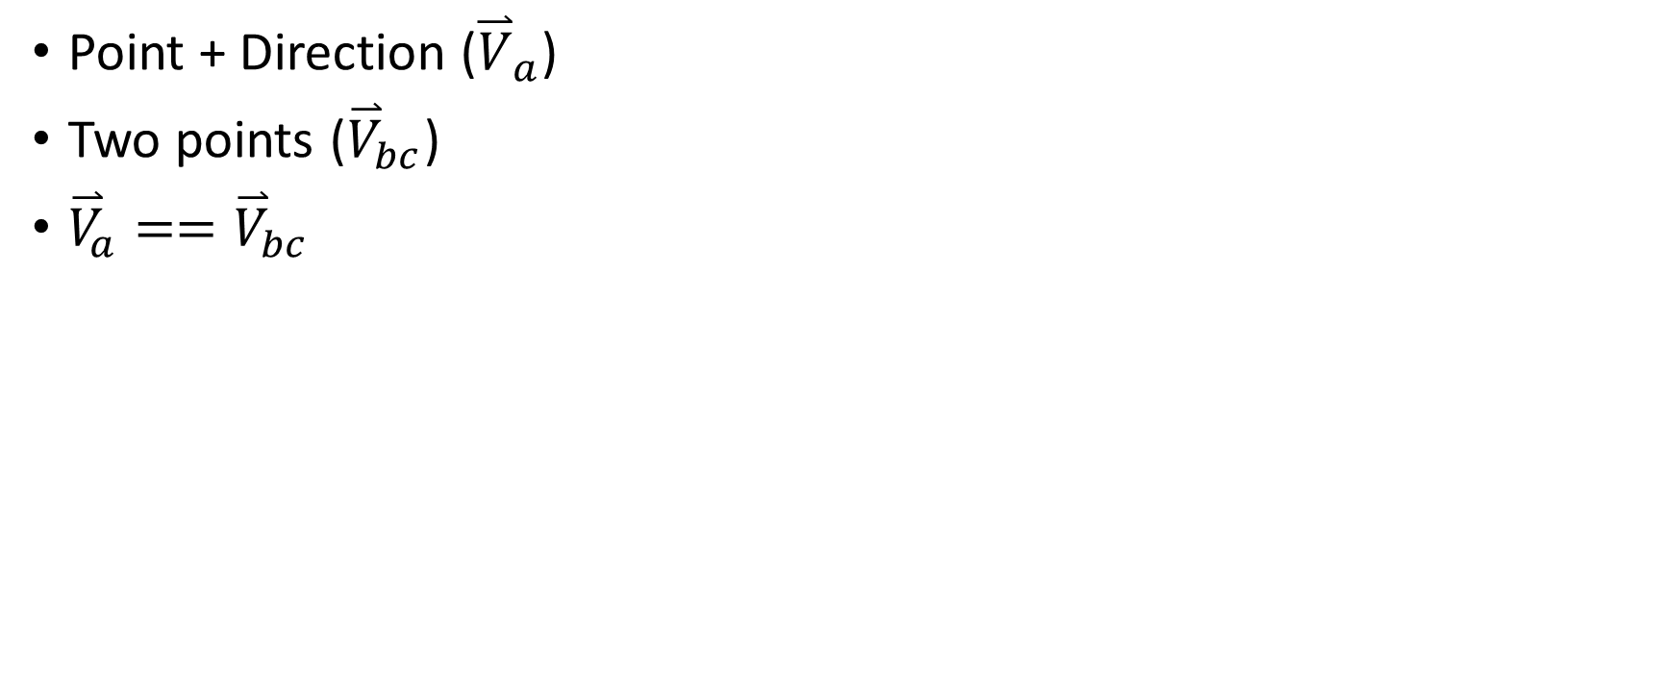
Vectors: direction and size
Point + Direction (${\overset{⃑}{V}}_{a}$)
Two points (${\overset{⃑}{V}}_{bc}$)
${\overset{⃑}{V}}_{a}=={\overset{⃑}{V}}_{bc}$

Slide 17
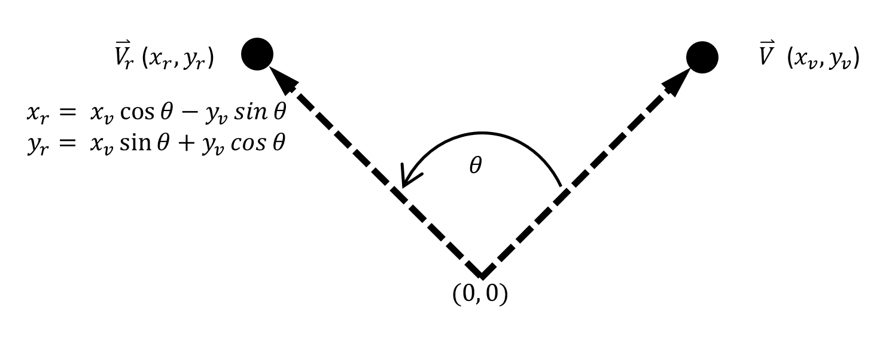
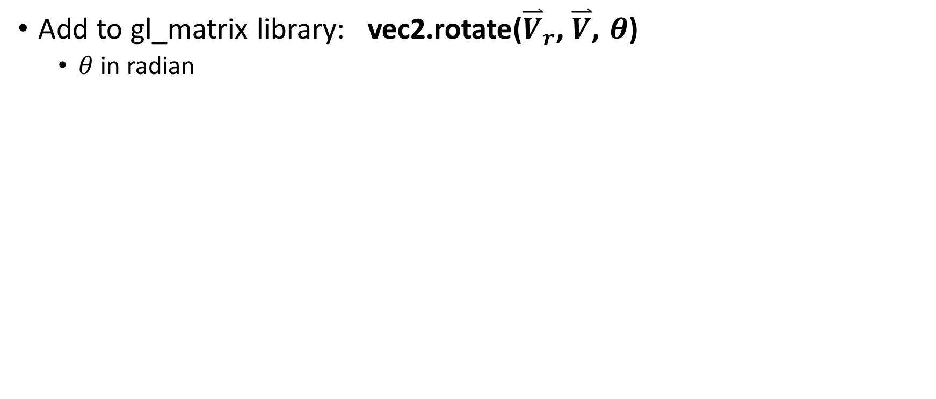
Vector: rotation
Add to gl_matrix library: vec2.rotate(${\overset{⃑}{V}}_{r}\text{,} \overset{⃑}{V}$, $θ$)
$θ$ in radian

Slide 18
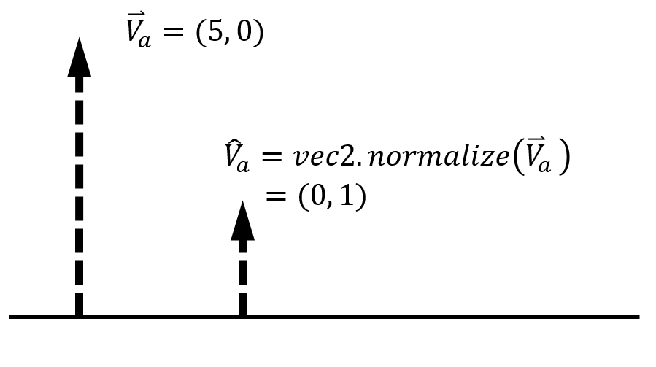
Vectors: normalization

Slide 19
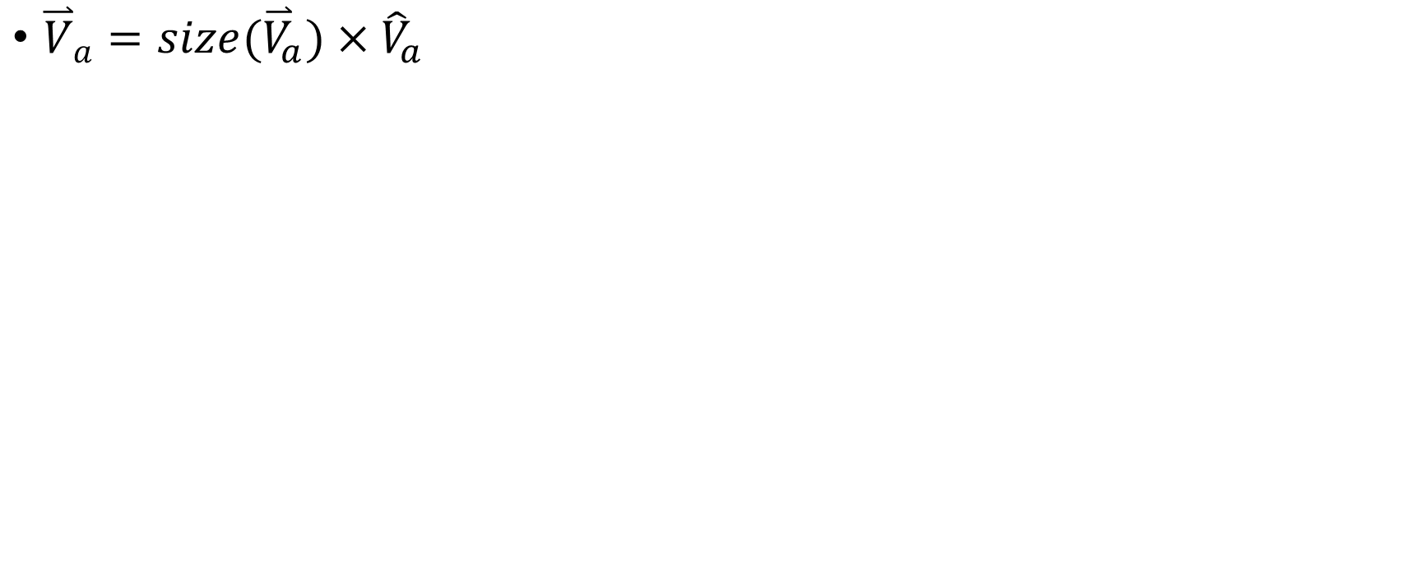
Vectors: normalization
${\overset{⃑}{V}}_{a}=size({\overset{⃑}{V}}_{a})×{\hat{V}}_{a}$

Slide 20

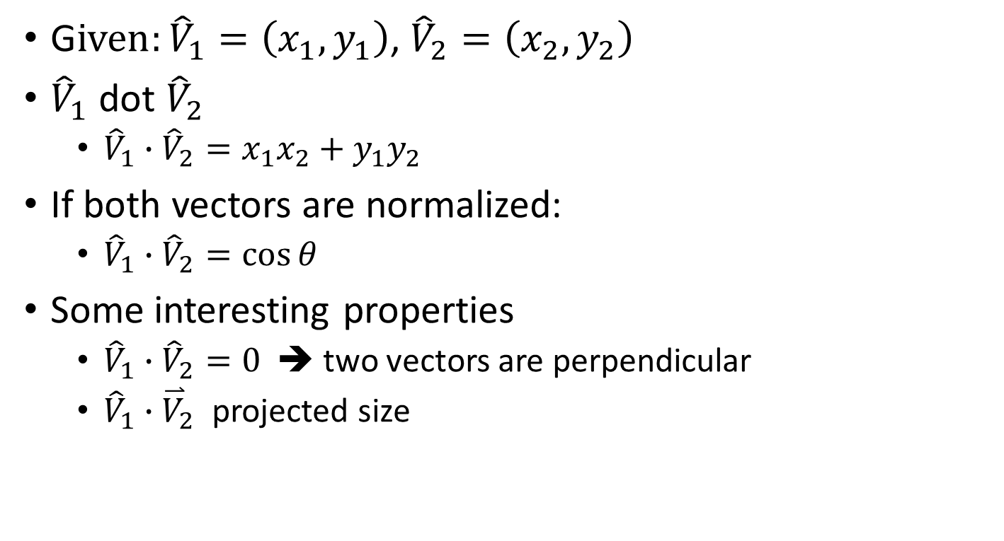
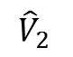
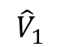
Vector: dot product
$${\hat{V}}_{1}$$
G$iven:{\hat{V}}_{1}=\left(x_{1},y_{1}\right)$, ${\hat{V}}_{2}=\left(x_{2},y_{2}\right)$
${\hat{V}}_{1}$ dot ${\hat{V}}_{2}$
${\hat{V}}_{1}∙{\hat{V}}_{2}={x_{1}x}_{2}+y_{1}y_{2}$
If both vectors are normalized:
${\hat{V}}_{1}∙{\hat{V}}_{2}=\cos{θ}$
Some interesting properties
${\hat{V}}_{1}∙{\hat{V}}_{2}=0$ ➔ two vectors are perpendicular
${\hat{V}}_{1}∙{\overset{⃑}{V}}_{2}$ projected size
$${\hat{V}}_{2}$$
$$θ$$

Slide 21
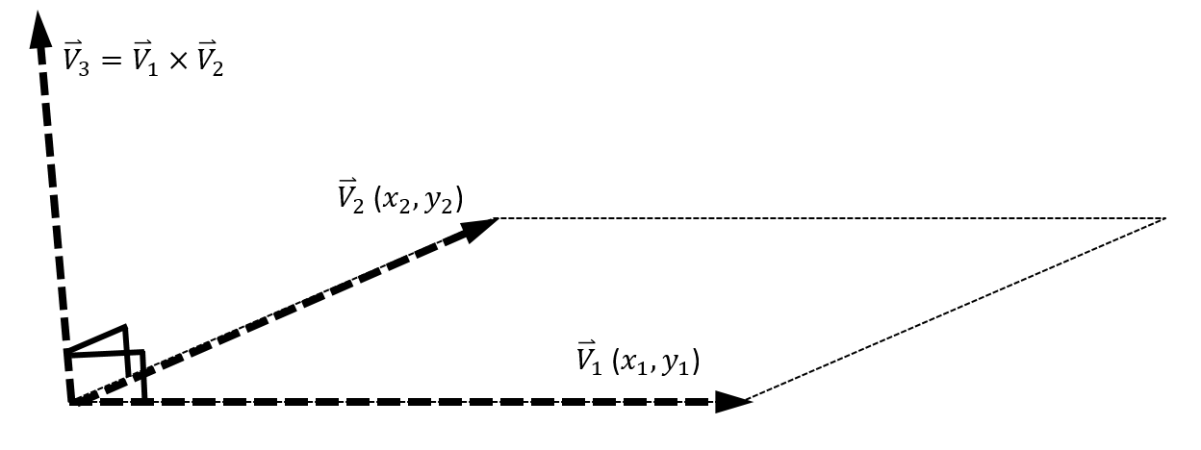
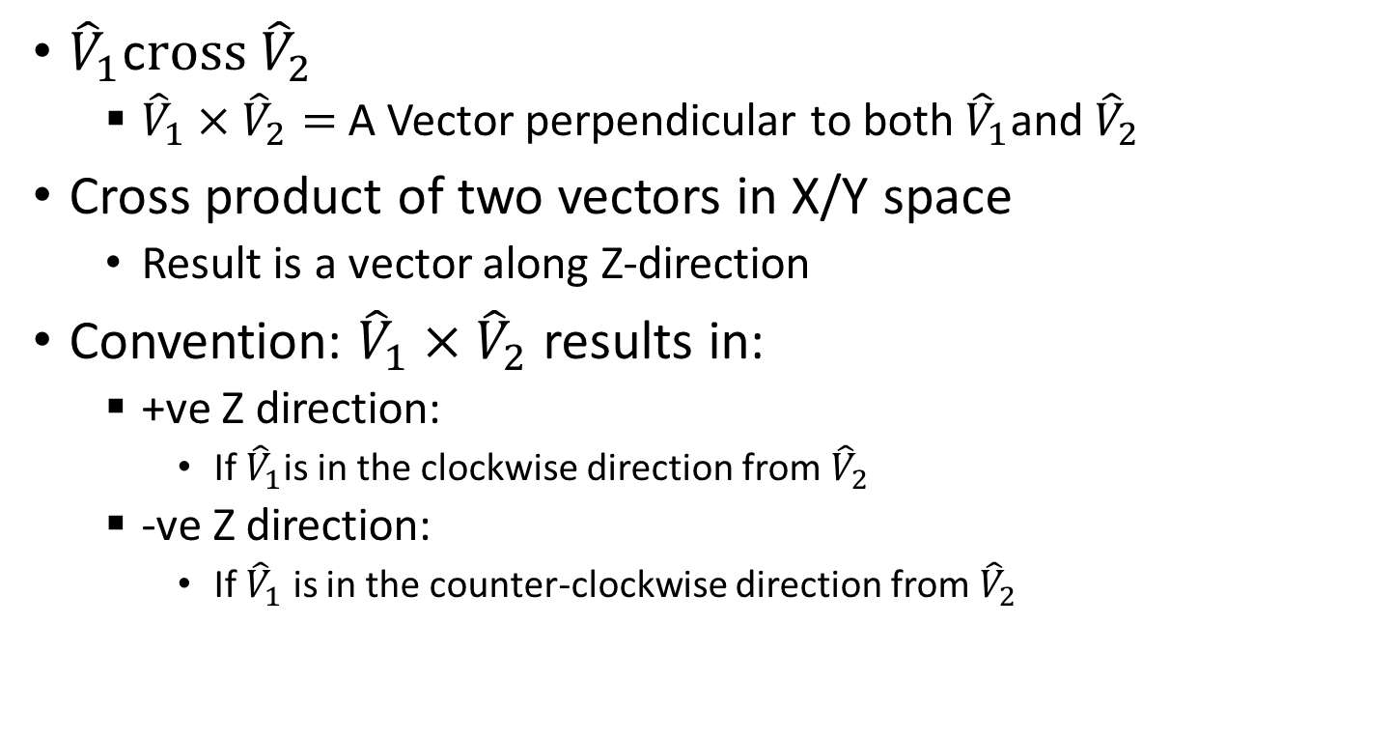
Vector: cross product
${\hat{V}}_{1}$c$ross {\hat{V}}_{2}$
${\hat{V}}_{1}×{\hat{V}}_{2}=$ A Vector perpendicular to both ${\hat{V}}_{1}$and${\hat{V}}_{2}$
Cross product of two vectors in X/Y space
Result is a vector along Z-direction
Convention: ${\hat{V}}_{1}×{\hat{V}}_{2}$ results in:
+ve Z direction:
If ${\hat{V}}_{1}$is in the clockwise direction from${\hat{V}}_{2}$
-ve Z direction:
If ${\hat{V}}_{1}$ is in the counter-clockwise direction from${ \hat{V}}_{2}$

Slide 22
Practice
I am traveling at v=(3, 4)
Is v a speed or velocity? And Why
How fast am I moving?
What is the direction I am moving towards?
If I were to look at my movement ONLY along the x-axis, how fast am I moving?
If I were to look at my movement ONLY along the direction: A=(0.707, 0.707), how fast am I moving?

Slide 23
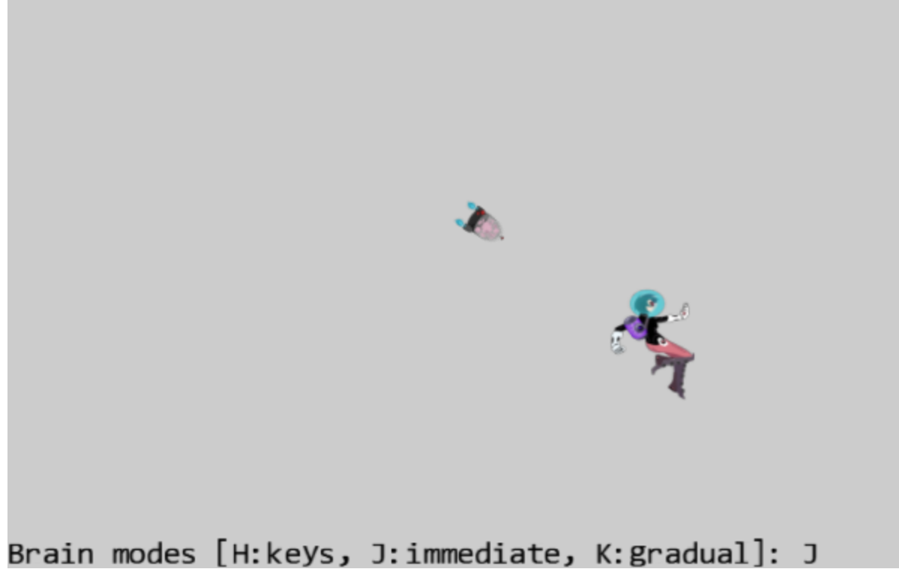
6.2: Front and Chase Project

Slide 24
6.2: Goals
work with velocity: as speed and direction
practice traveling along a predefined direction
implement chasing or home-in behavior

Slide 25
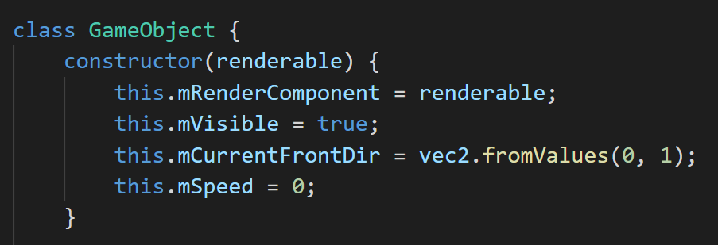

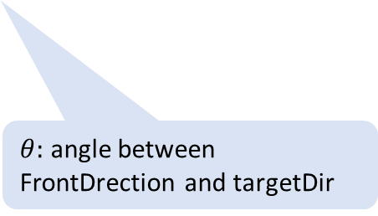
GameObject: initial state
$θ:$ angle between FrontDrection and targetDir
Initial front direction

Slide 26
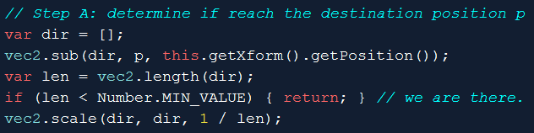
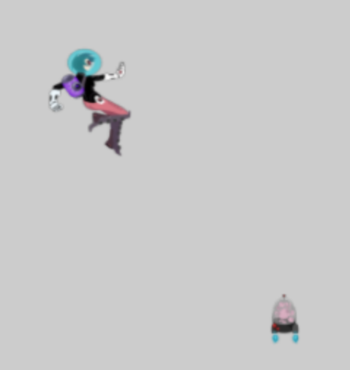
GameObject::rotateObjPointTo(p)
Position: p
dir: towards p
len (length of dir)
this.getXform().getPosition()

Slide 27
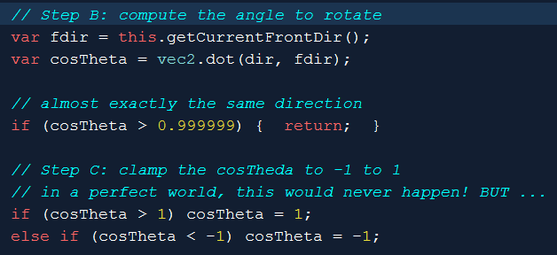
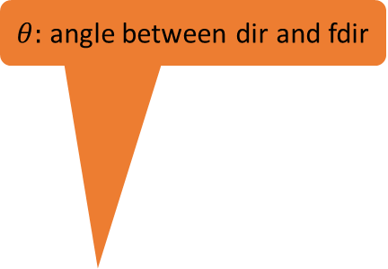
GameObject::rotateObjPointTo(p)
Position: p
$θ:$ angle between dir and fdir
dir: towards p
fdir: front of object
len (length of dir)
this.getXform().getPosition()

Slide 28
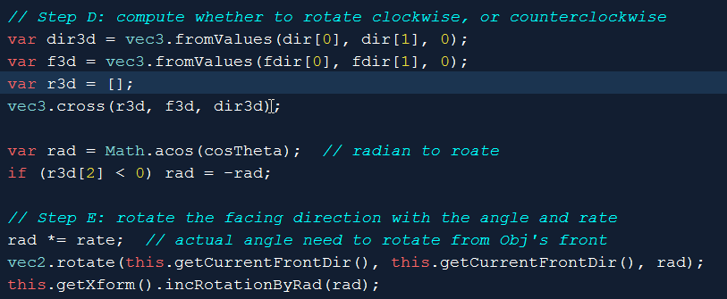
GameObject::rotateObjPointTo(p) cont …
this.getXform(): set rotation

Slide 29
MyGame: set/get
Set/get: speed front-direction
Update:
Movement along front-direction
Draw
Draw the Renderable

Slide 30
Testing: the Brian
Setting
Constant traveling speed
Initially front is the default (y-direction)
Private behavior (in update)
Drive the brain with keyboard
Change speed
Direction and Speed are independent

Slide 31
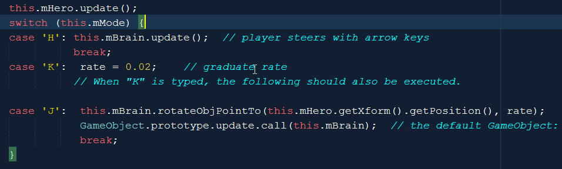
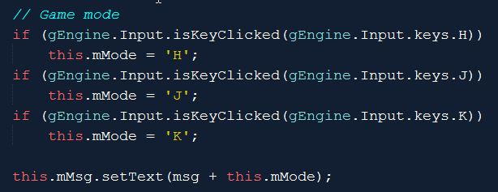
MyGame::update
Default is: 1.0

Slide 32
On GameObject::rotateObjPointTo(p)
In each case, why are we returning?
Why are we comparing to such strange floating point numbers?

Slide 33
On the Brain: Why do we need this line?

Slide 34
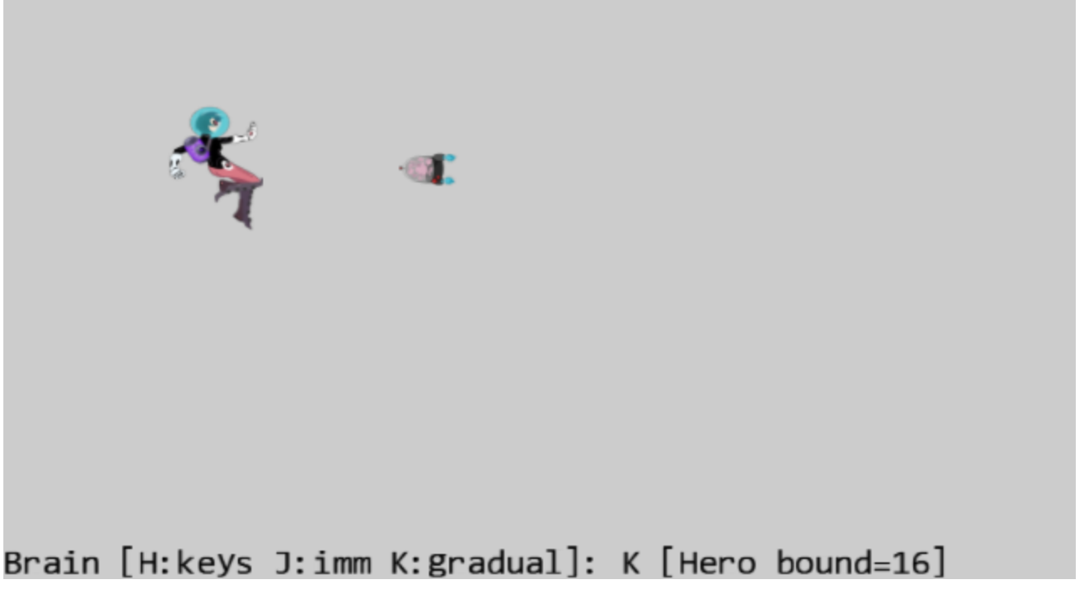
6.3: BBOX and Collision Project

Slide 35
6.3: Goals
understand bounding box and its implementation
experience working with bounding box of a GameObject
compute and work with the bounds of a Camera WC window
program with collisions

Slide 36
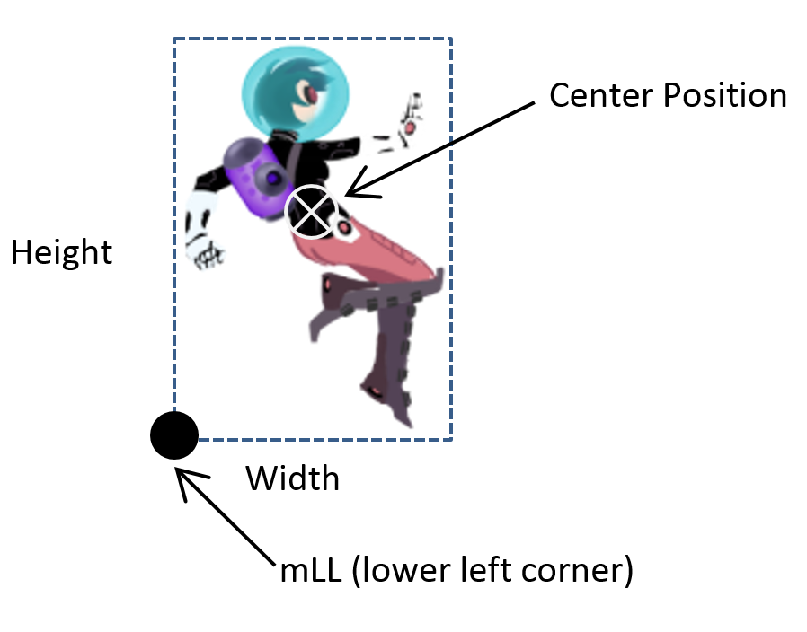
Bounding Box
Always major-axis aligned
4 floats in 2D
Point + Dimension
Center + W x H
Lower Left + W x H
2 points
Lower Left + Upper Right
“Easy” (efficient) to compute overlaps!!

Slide 37
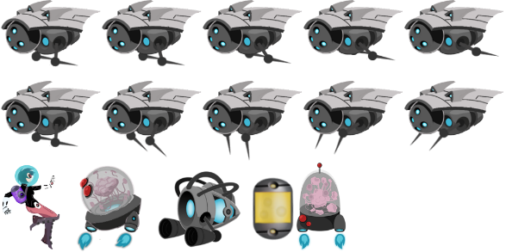
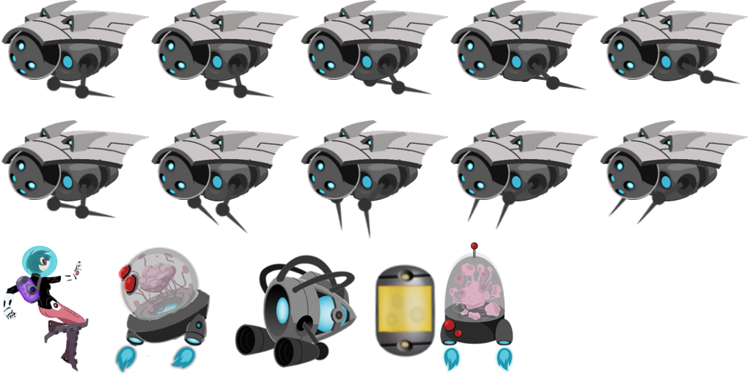
BoundingBox class
Bound: Lower-left + width + height
Set bound
No get bound method, instead get min/max
Bound tests
Contains a point
Intersects with another bound
(maxX, maxY)
(minX, minY)

Slide 38
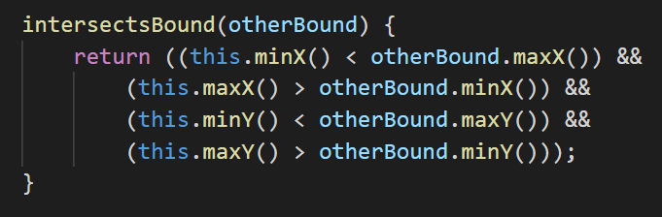
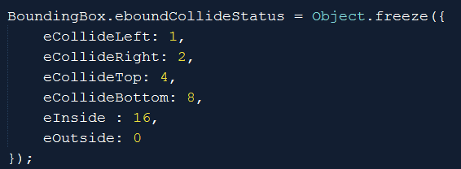
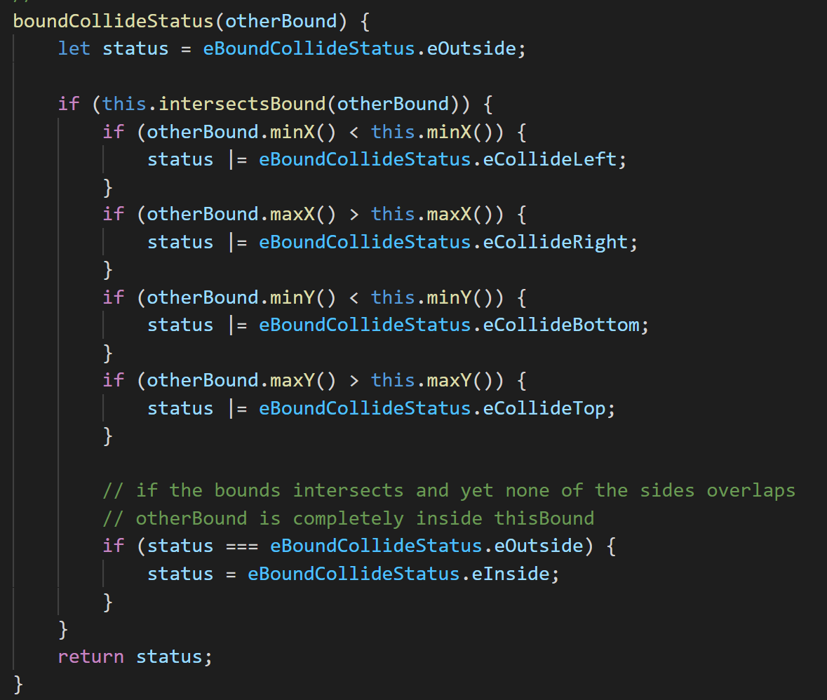
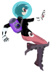
Bbox: Collision status
eCollideRight
eCollideTop
eCollideLeft
eCollideLeft | eCollideBottom
eCollideBottom
eOutside

Slide 39
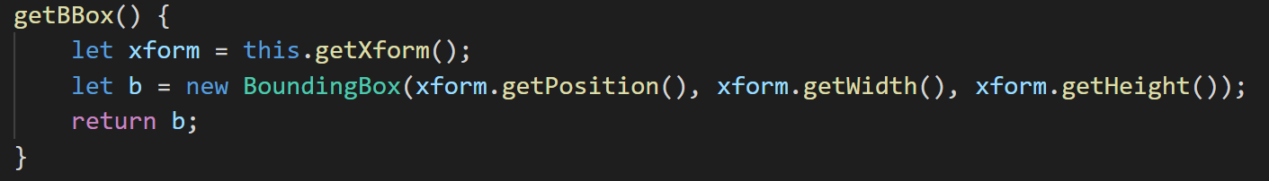
Using Bbox in GameObject
Design decision: compute on the fly! (in game_object.js)
Good:
No state to maintain (no need to update after xform change)!
Bad:
Not free to create
Bbox inquiry should be done no more than once per object per update

Slide 40
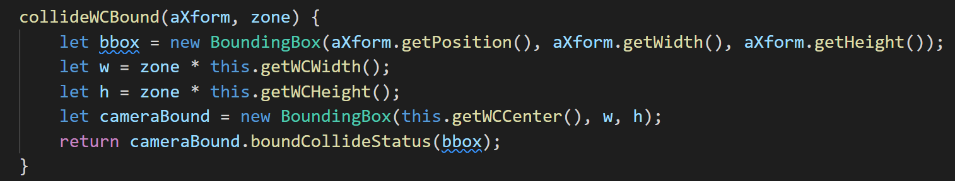
Using Bbox in Camera
Collide a xform with WCBounds (in camera.js)
Zone: a percentage of WC Bounds
WC Center
eCollideLeft
Camera WC Bounds
zone
eOutside

Slide 41
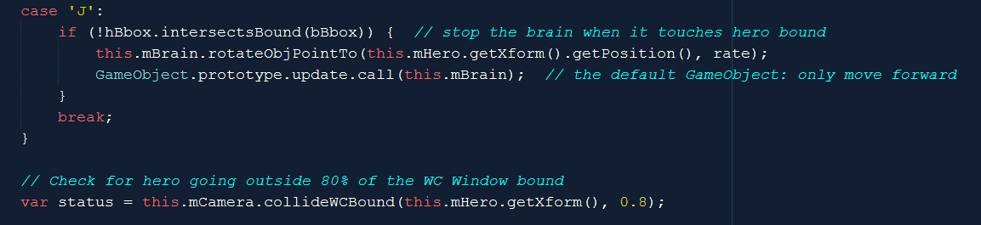
Testing Bbox
Stop brain
Print status as a number:

Slide 42
Try
Hero bound status:
When outside?
What is 6?
How about 12?
If change the bound % from 0.8 to 0.2 what will happen?
Change the rate in MyGame
Try change from 0.02 to something much slower (like 0.001)
What will happen?

Slide 43
Try
Hero bound status:
When outside?
0
What is 6?
2+4 ➔top-Right
How about 12?
4+8➔Top-Bottom (tall object)
If change the bound % from 0.8 to 0.2 what will happen? ➔ easy for the object to be “outside”
Change the rate in MyGame
Try change from 0.02 to something much slower (like 0.001)
➔ Takes forever to turn towards the target

Slide 44
Try others
Change the rate in MyGame
Notice the tendency/potentials of “orbiting”
Increase/decrease Brain speed (Up/Down arrows)
To see different orbiting behaviors

Slide 45
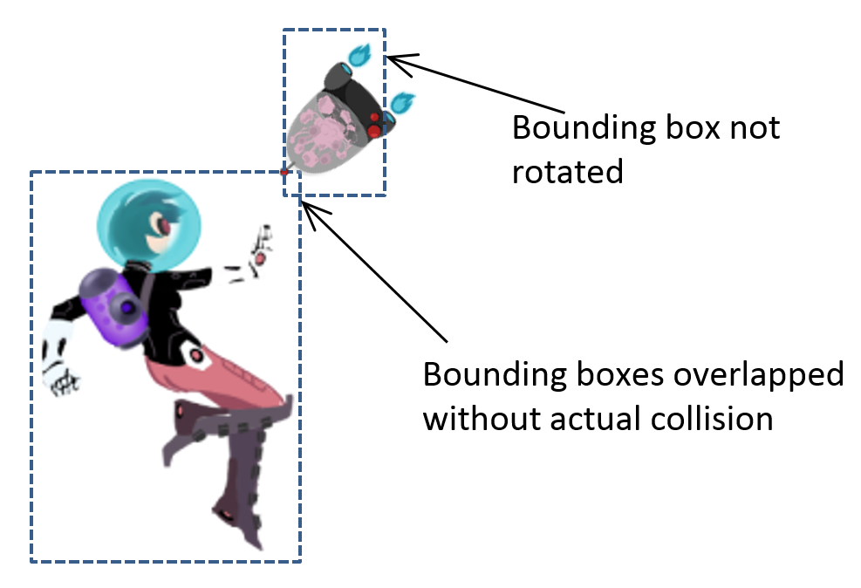
Important limitation of Bbox
Axis aligned
Void space
Our implementation no support for rotation!

Slide 46
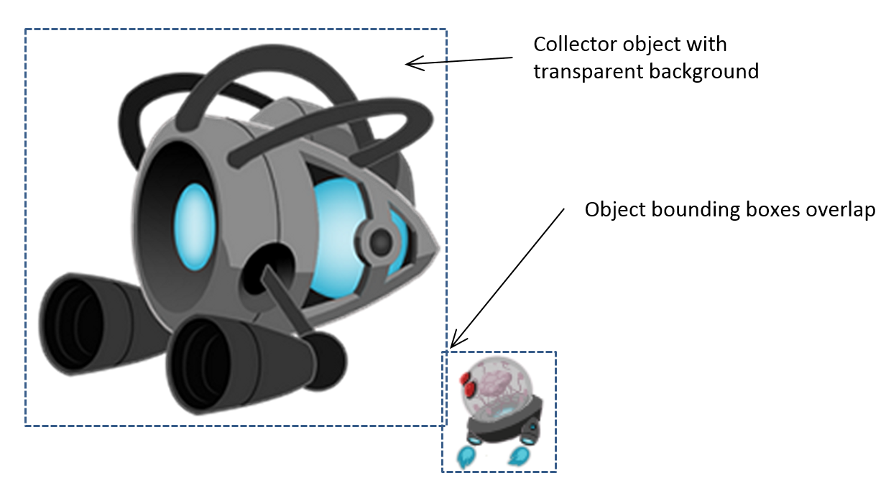
Problem with Bbox
We have seen: does not support rotation (at all!)
Even in the absence of rotation
Does not approximate collision well
Too much void space!
Collision: pixel overlaps!

Slide 47
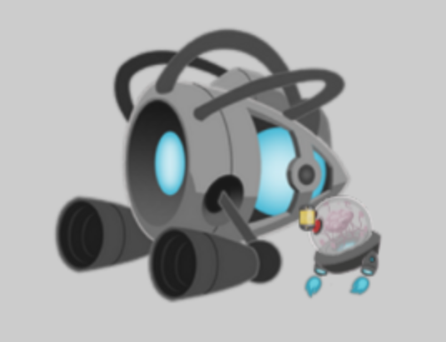
6.4: Per Pixel Collisions Project

Slide 48
6.4: Goals
Derive per-pixel collision detection algorithm
Implement the algorithm
Understand the limitations and run-time complexity

Slide 49
Separating implementation source code
TextureRenderable: implemented in three files
texture_ renderable_main.js
Define the basic TextureRenderable class functionality
texture_ renderable_pixel_collision.js
Import from texture_ renderable_main.js
For the basic TextureRendearble functionality
Append pixel collision functionality to the class
WATCH the syntax, very strange and intimidating. Well, get used to it
texture_renderable.js : access file (to import from)
Import from texture_ renderable_pixel_collision.js
For all the implementations of TextureRenderable functionality
All “users” of TextureRenderable must import from texture_renderable.js
E.g. in engine/index.js

Slide 50
Per-pixel accurate collision detection
Detect one of the non-transparent pixel overlaps
Good at answer: yes or no
BAD at answering: where
Does not answer: “first collision point”
Runtime:
VERY sensitive to image resolution (as expected)
VERY sensitive to which image collide with which!? ←

Slide 51
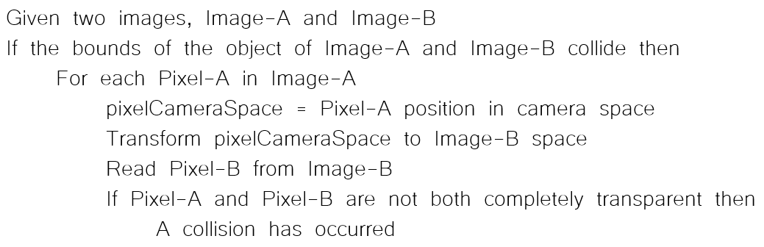
Colliding pixels of two images
Each of images, A and B are in WC space
Algorithm:

Slide 52


Algorithm: explained
Image-A, 6x5pixels
WC Size: 60x50
Lower-Left corner at WC (5,5)
Image-B, 3x4 pixels
WC size: 30x40
Lower-Left corner at WC (45, -15)

Slide 53
In WC:
WC origin: (0, 0)

Slide 54
In WC:
WC Space: (5,5)
WC origin: (0, 0)

Slide 55
In WC:
Width = 60
Height = 50
WC Space: (5,5)
WC origin: (0, 0)

Slide 56
In WC:
Width = 60
Height = 50
WC Space: (5,5)
WC origin: (0, 0)
WC Space: (45, -15)

Slide 57
In WC:
Width = 60
Height = 50
WC Space: (5,5)
WC origin: (0, 0)
Height = 40
WC Space: (45, -15)
Width = 30

Slide 58
WC Space: (65,55)
Image-A Pixel: (0,2)
WC: (10, 30)
Image-A Pixel: (5,1)
WC: (60, 20)
Image-B Pixel: (1, 3)
WC: (60, 20)
WC Space: (5,5)
Image-B Pixel: (2, 0)
WC: (70, -10)
WC Space: (45, -15)

Slide 59
WC Space: (65,55)
Image-A Pixel: (5,1)
WC: (60, 20)
Image-A space: pixel (5,1)
WC space: (60, 20)
Image-B space: pixel (1, 3)
Per-pixel collision Algorithm test
Image-A pixel (5,1) against
Image-B pixel (1,3)
Image-B Pixel: (1, 3)
WC: (60, 20)

Slide 60
The algorithm again
Image-A space: pixel (5,1)
WC space: (60, 20)
Image-B space: pixel (1, 3)
Per-pixel collision Algorithm test
Image-A pixel (5,1) against
Image-B pixel (1,3)

Slide 61
Per-pixel accurate collision: run time?
Runtime:
Worst case: O(W x H)
WxH is the resolution of Image A
Choose Image-A wisely!!
Collision between a small projectile (16x32) and the hero (128x64)!
Memory complexity?
CPU need to have access to color!
For both images!
O(W x H): of the larger image!
Expensive memory!

Slide 62
Questions
Given TextureRenderable-A
Texture resolution 10x20 texels
Xform: Position (15, 20), Size(20, 40)
P_{(7,9)} = The WC location of texel (7, 9), what is this?
In the same world, I have TextureRenderable-B:
Texture resolution 20x30 texels
Xform: Position (10, 10), Size(40, 60)
What is the (k, l) index of P_{(7,9)}
If, we replace all numbers with symbols:
Texture resolution: M_{A} x N_{A} , WC Locaiton/Size: (x_{A}, y_{A}) and, W_{A} x H_{A}
Texture resolution: M_{B} x N_{B} , WC Locaiton/Size: (x_{B}, y_{B}) and, W_{B} x H_{B}
Find (k, l) for each (i, j)

Slide 63
Questions
Given TextureRenderable-A
Texture resolution 10x20 texels
Xform: Position (15, 20), Size(20, 40)
P_{(7,9)} = The WC location of texel (7, 9), what is this?
Width of one texel in WC space: w_{t} =20 / 10 = 2
Height of one texel in WC space: h_{t} =40 / 20 = 2
In WC, Texel (7,9) is (7w_{t}, 9h_{t}) from the lower left corner of the Renderable
Lower-left corner of the Renderable: (15 – 20/2, 20-40/2) = (5, 0)
Texel (7,9) is (7w_{t}, 9h_{t}) + (5, 0) = (7*2, 9*2) + (5, 0) = (14+5, 18) = (19, 18)

Slide 64
Questions
Given TextureRenderable-A ➔ P_{(7,9)} is (19, 18)
In the same world, I have TextureRenderable-B:
Texture resolution 20x30 texels
Xform: Position (10, 10), Size(40, 60)
What is the (k, l) index of P_{(7,9)}
Lower-left corner of B is: (10-40/2, 10-60/2) = (-10, -20)
P_{(7,9)} distant from lower-left corner: (19-(-10), 18-(-20)) = (29, 38)
% size covered in X/Y: (29/40, 38/60) = (0.725, 0.6333)
Index (k, l): (0.725 x 20, 0.633 x 30) = (14.5, 19)

Slide 65
Questions
If, we replace all numbers with symbols:
Texture resolution 10x20 M_{A} x N_{A} texels
Xform: Position (15, 20) (x_{A}, y_{A}) , Size(20, 40) W_{A} x H_{A}
Width of one texel in WC space: w_{t} =20 / 10 = 2 ➔ w_{t} = M_{A} / W_{A}
Height of one texel in WC space: h_{t} =40 / 20 = 2 ➔ h_{t} = N_{A} / H_{A}
In WC, Texel (7,9) is (7w_{t}, 9h_{t}) from the lower left corner of the Renderable ➔ (ixw_{t}, jxh_{t})
Lower-left corner of the Renderable: (15 – 20/2, 20-40/2) = (5, 0) ➔ (x_{A}-W_{A}/2, y_{A}-H_{A}/2)
Texel (7,9) is (7w_{t}, 9h_{t}) + (5, 0) =
Texel(I, j): (ixw_{t}, jxh_{t}) + (x_{A}-W_{A}/2, y_{A}-H_{A}/2)
➔ Xposition: i * w_{t} + (x_{A}-W_{A}/2) or i * (W_{A} / M_{A} ) + (x_{A}-W_{A}/2)

Slide 66
Questions
Given TextureRenderable-A ➔ P is (x_{p}, y_{p})
In the same world, I have TextureRenderable-B:
Texture resolution 20x30 texels ➔ M_{B} x N_{B}
Xform: Position (10, 10) (x_{B}, y_{B}), Size(40, 60) W_{B} x H_{B}
Lower-left corner of B is: (10-40/2, 10-60/2) ➔ (x_{l} , y_{l}) = (x_{B}-W_{B}/2, y_{B}-H_{B}/2)
P_{(7,9)} distant from lower-left corner: (8.5-(-10), 4.5-(-20)) ➔ (x_{p}-x_{l}, y_{p}-y_{l})
% size covered in X/Y: (18.5/40, 24.5/60) = (x_{d} , y_{d}) = ((x_{p}-x_{l})/W_{B} , (y_{p}-y_{l})/H_{B})
Index (k, l): (0.4625 x 20, 0.4083 x 30) = (x_{d} * M_{B} , y_{d} * N_{B})
Index-K = x_{d} * M_{B} = (x_{p}-x_{l})/W_{B} * M_{B}= (x_{p}- x_{B}+W_{B}/2) * 1/W_{B} * M_{B}
= [(x_{p}- x_{B})/W_{B} + ½] * M_{B}

Slide 67
Store color in CPU: texture.js
TextureInfo: structure, now keeps track of a color array
New function: getColorArray()
If not already done so
transfer pixels of file texture from GPU to CPU
Store in TextureInfo
Texture map returned as a 1D array of floats!
Every 4x float is one color
Row major (r0c0, r0c1, r0c2, …)

Slide 68
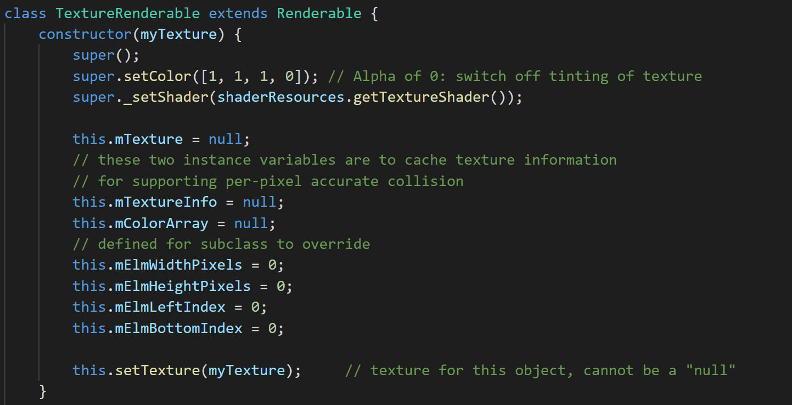
TextureRenderable: caching info

Slide 69
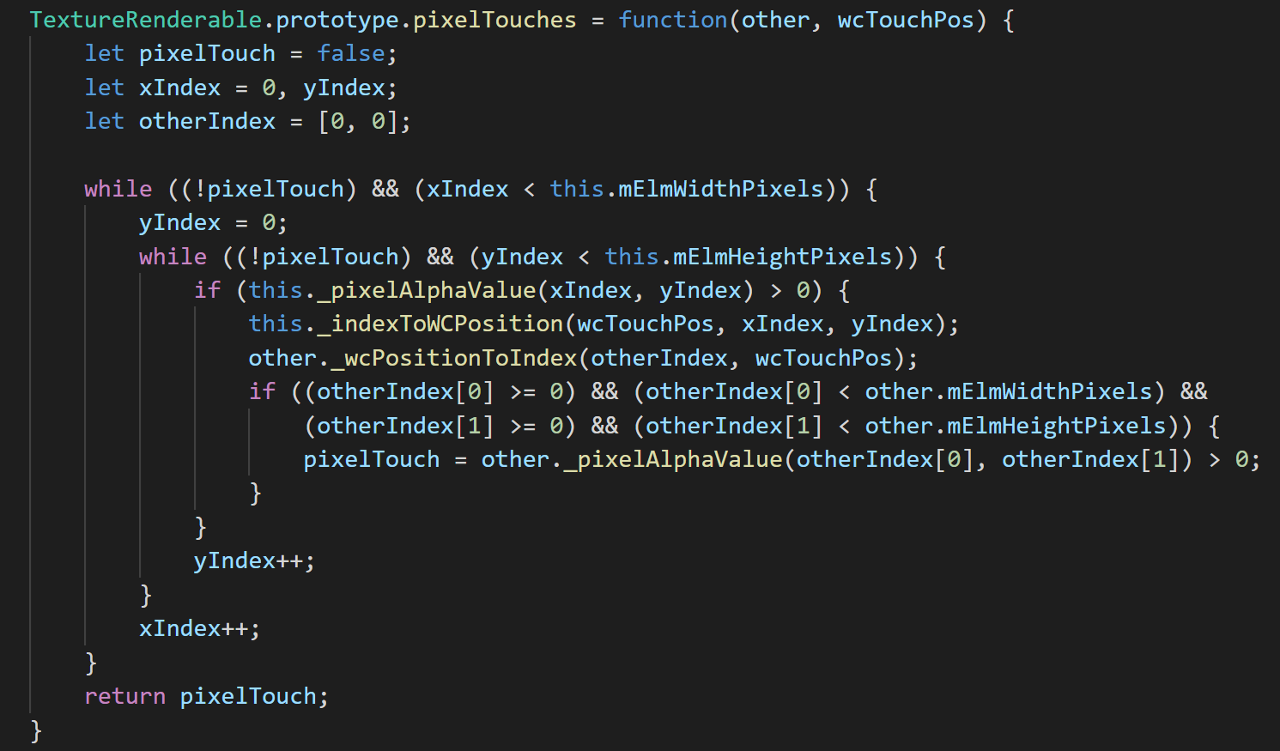
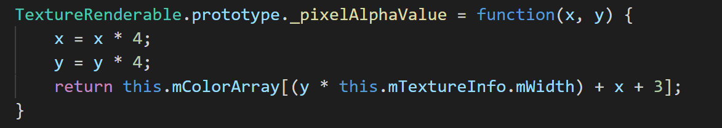
texture_renderable_pixel_collision.js
First detected position: no other meaning!
First detected position: no other meaning!

Slide 70
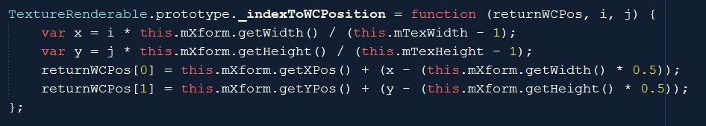

Index (Image Space) to WC
Image: Resolution: TexWidth x TexHeight
WC size: Xform.getWidth() x Xform.getHeight()
Texel width in WC = Xform.getWidth() / TexWith
WC location for pixel (i, j):
LowerLeft.x + i * Texel-Width-in-WC
LowerLeft.x = Xform.getXPos() – (Xform.getWidth() * 0.5)

Slide 71


WC position to Image pixel
normalizeSize (like UV): delta / WC-Size
Pixel-x = Image resolution * normalizeSize
wcPos
delta
Xform.getPosition()
(center of obj)

Slide 72
Remember, the algorithm

Slide 73


game_object.js:: new function
texture_renderable_pixel_collision.js

Slide 74

Testing: per-pixel
Choice of the Image-A
Try changing “image-A”
my_game.js update()

Slide 75
Per-Pixel Collision
Accurate Yes/No result
Cannot tell where (not well at least)
Computation cost:
O(Smaller image resolution)
Memory cost
O(Larger image resolution)
Can be costly!
Problem:
Does not support rotated image!

Slide 76


Vector Review: component & decomposition
Vector: $\overset{⃑}{V}$
Perpendicular component vectors:
$\hat{i}$ and $\hat{j}$
Decompose $\overset{⃑}{V}$ for components of $\hat{i}$ and $\hat{j}$
Component of $\hat{i}=\left(\overset{⃑}{V}∙\hat{i}\right)$
Component of $\hat{j}=\left(\overset{⃑}{V}∙\hat{j}\right)$
Always true:
$\overset{⃑}{V}=\left(\overset{⃑}{V}∙\hat{i}\right)\hat{i}+\left(\overset{⃑}{V}∙\hat{j}\right)\hat{j}$
Notes:
Give an example for form pixel to WC space.
Example from WC space back to pixel

Slide 77

With rotated component vectors …
Notes:
Use the same example for pixel to WC space, and WC space back to pixel

Slide 78


In our case:

Slide 79

6.5: General Pixel Collisions Project

Slide 80
6.5: Goals
Apply vector component and decomposition concepts to access pixels in rotated image
Derive and solve per-pixel collisions for rotated textured objects

Slide 81

The new pixelTouches function
Compute the rotated components: $\hat{L}$ and $\hat{M}$
By rotating the default X and Y component vectors: $\hat{i}$ and $\hat{j}$

Slide 82


Index (image space) to WC
(i, j)
xDir, yDir: $\hat{L}$ and $\hat{M}$
yDir
xDir
x y : (i,j) * pixel size in WC
xDisp/yDisp: distance to the center of object
Offset from center of object along xDir/yDir

Slide 83

WC to image space (index):
wcPos
Old way: decompose assuming x/y components
yDir
xDir
New way: decompose explicitly with dot products
No change!

Slide 84


game_object: Bbox test!
myR
myR
mySize[0] [1]

Slide 85
Where are we?
Per-pixel accurate collision algorithm implemented
Reviewed vector component and decomposition concept
Support rotated textures for per-pixel accurate collision
Last refinement: Support for Sprite Elements

Slide 86

6.6: Sprite Pixel Collisions Project
Goal: generalize per-pixel for sprite elements

Slide 87

All a matter of reference position: the origin
A Texture
Given index (i, j): offset from the “Origin”
For TextureRenderable: Offset
Offset reference is: (0,0)
For SpriteRenderable:
Offset reference is lower-left corner
Index (i, j)
i-^{th} and j-^{th} pixel with respect to lower-left corner, or (0, 0)
A Sprite Element
A Sprite Sheet
Index (i, j): identifies a pixel with respect to the lower-left corner of element and not (0,0)

Slide 88

sprite_renderable.js
Override _setTexInfo():
Record sprite information: lower-left corner and size
Index of lower-left corner of current sprite element
mTexWidth/Height: size of sprite element (instead of the entire texture).
mTexWidth and mTexHeight: are used throughout TextureRenderable, SpriteRenderable, and SpriteAnimateRenderable.

Slide 89
Ensure to use sprite lower-left corner and size
SpriteRenderable,
calls _setTextureInfo() when sprite element changes
At the end of:
Constructor()
setElementUVCoordinate()
setElementPixelPositions()

Slide 90

Use the information during color lookup!
Index of texel for alpha look up
mTexBottomIndex/LeftIndex: are initialized to (0,0) for TextureRenderables

Slide 91
Ultimate test of per-pixel collision:
Hero/Brain:
SpriteRenderable
SpriteRenderable
Test for support of all Texture sub-classes
L/R/H/B: Colide with Portal
Brain: chase Hero
Minions: SpriteAnimateRenderable
Portal: TextureRenderable

Slide 92
Chapter 6: What did we learn?
Review vectors: size, direction, dot/cross, component, decomposition
Applying simple vector concepts
Chasing, Position calculation for pixels on rotated textures
Importance of GameObject
MyGame clear of specific object updates
MyGame can focus on inter-object relationships
Boundingbox: cheap, lousy accuracy, useful as a rough test
Per-Pixel accurate collision detection
For rotated images, for sprites,

Slide 93
Per-Pixel Accurate Collision
Costly: both computationally and memory-wise
Computation: O(smaller image)
Memory: O(larger image)
Functionality:
Yes/No answer to collision: very accurate! (at pixel level!)
Does not provide much insights into collision position
e.g., no support for first point of contact (difficult problem in general)

